Slide 1
IMG WAST trainee journey
Mohammed Elsankary
CT3 parklands hospital

Slide 2
Background and steps in the journey: -
-IMG graduate from Mansoura university in Egypt in 2011.
- Practiced medicine in Egypt following graduation for two years in different places ;worked as a resort doctor for one and half year in Sharm Elshiekh and Hurghada and worked in ministry of health in Egypt as medical officer for a year and then started working as psychiatry resident at home of hope hospital. During this time , passed USMLE exams and was preparing to move to the USA to complete my psychiatry training.
-Moved to the Maldives in 2017 stayed there for two and half years ( best experience in my life)
-Moved to the UK in August 2019 as part of the WAST scheme ( Widening accessibility to speciality training).

Slide 3
Challenges in the Journey
- Challenges in the first few weeks to a year: -
1- Accommodation.
2- What you left behind to come here and how much pressure that put on you e.g ; career.
3- Doubt and fear from everything and about everything ( can be consuming at the beginning )
4- Reason for coming here, is it all about achieving your dreams , was it all that easy ?
5- You are a hero, or at least this what I thought cos you left all what you had behind and in your mind you are a hero and it is painful to leave everything behind , but are you really a hero ?! Was an ongoing painful question.
6- Having to prove yourself to everyone that you are legitimate and valid and that you mean well and that you are not an alien and that you are just like everyone else.

Slide 4
Challenges:
7-Burnt my boats and there is no way back and all the hard work must be paid off , always have very high expectations of yourself and others having high expectations of you as well, remember YOU ARE THE HERO!
-With all of this in mind, I finally realised why I was not happy like everyone else.

Slide 5
What other IMGs have said : -
-In many forums and other social media platforms, many IMGs share similar stories and have similar experiences, different names from different countries with different languages but all of them agreed on one thing, that It was not easy as it looked like !

Slide 6
Supervisor –trainee relationship.
--Supervisor- Trainee relationship is an unprecedented experience for most of IMGs and could sound scary and intimidating as you do not know what to expect or how to behave. Lots of baffling questions about this relationship , what is this relationship about ? Are they here to support us or criticise us ?
-Supportive relationship with supervisor would be unfamiliar and alien for most IMGs.
-Unsupportive supervisor will bring back some of previous traumatic experience and stop IMGs from seeking support cos of your previous experiences and make them regress as defence against the anxiety that this trauma may bring, so we could see things like: silence and isolation from the team at work, avoidance of interaction with patients and colleagues and sometimes passive aggression and paranoia.

Slide 7
Support for IMGs locally : -
1-IMG Rep and IMG champion in the trust.
2-Induction and welcome pack
3-GMC training for IMGs and start the communication skills training.
4-Setting up CASC training with IMGS with Our champion.
5-IMG trainees forum and whatsupp group
6-Any queries get addressed as well in the IMG trust forum
7-Better links with the clinical tutor working group.
8-IMG mentorship program with other trainees
9-Sorting out IMG consultant mentors

Slide 8
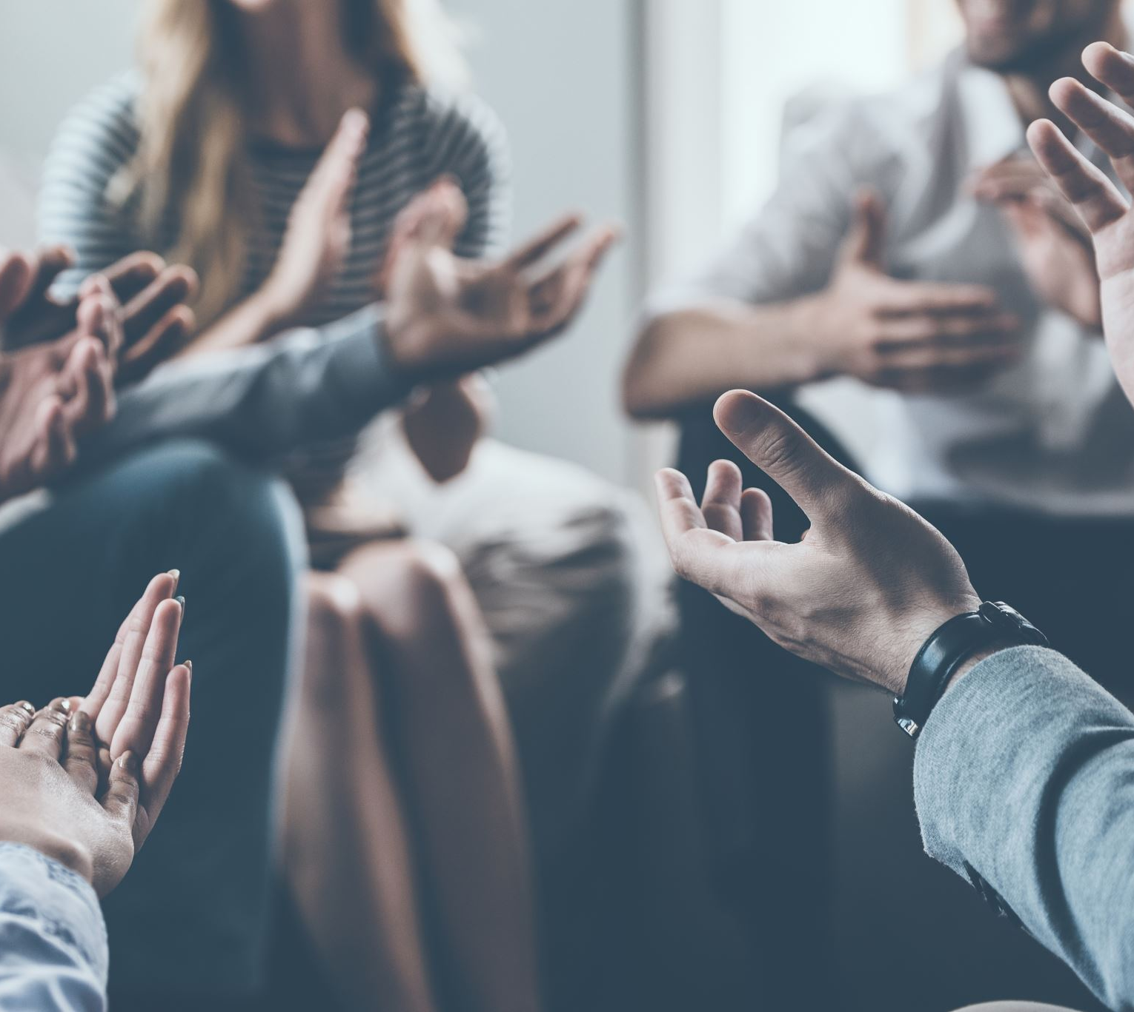
The End.
Thank you for listening.

